Slide 1
Graphical Abstract Icons
In case you would like to use icons in your graphical abstract please use the ones provided on the following slides.
Please use icons sparingly and ensure that they enhance the message of your graphical abstract and support instant grasping of what is shown.

Slide 2
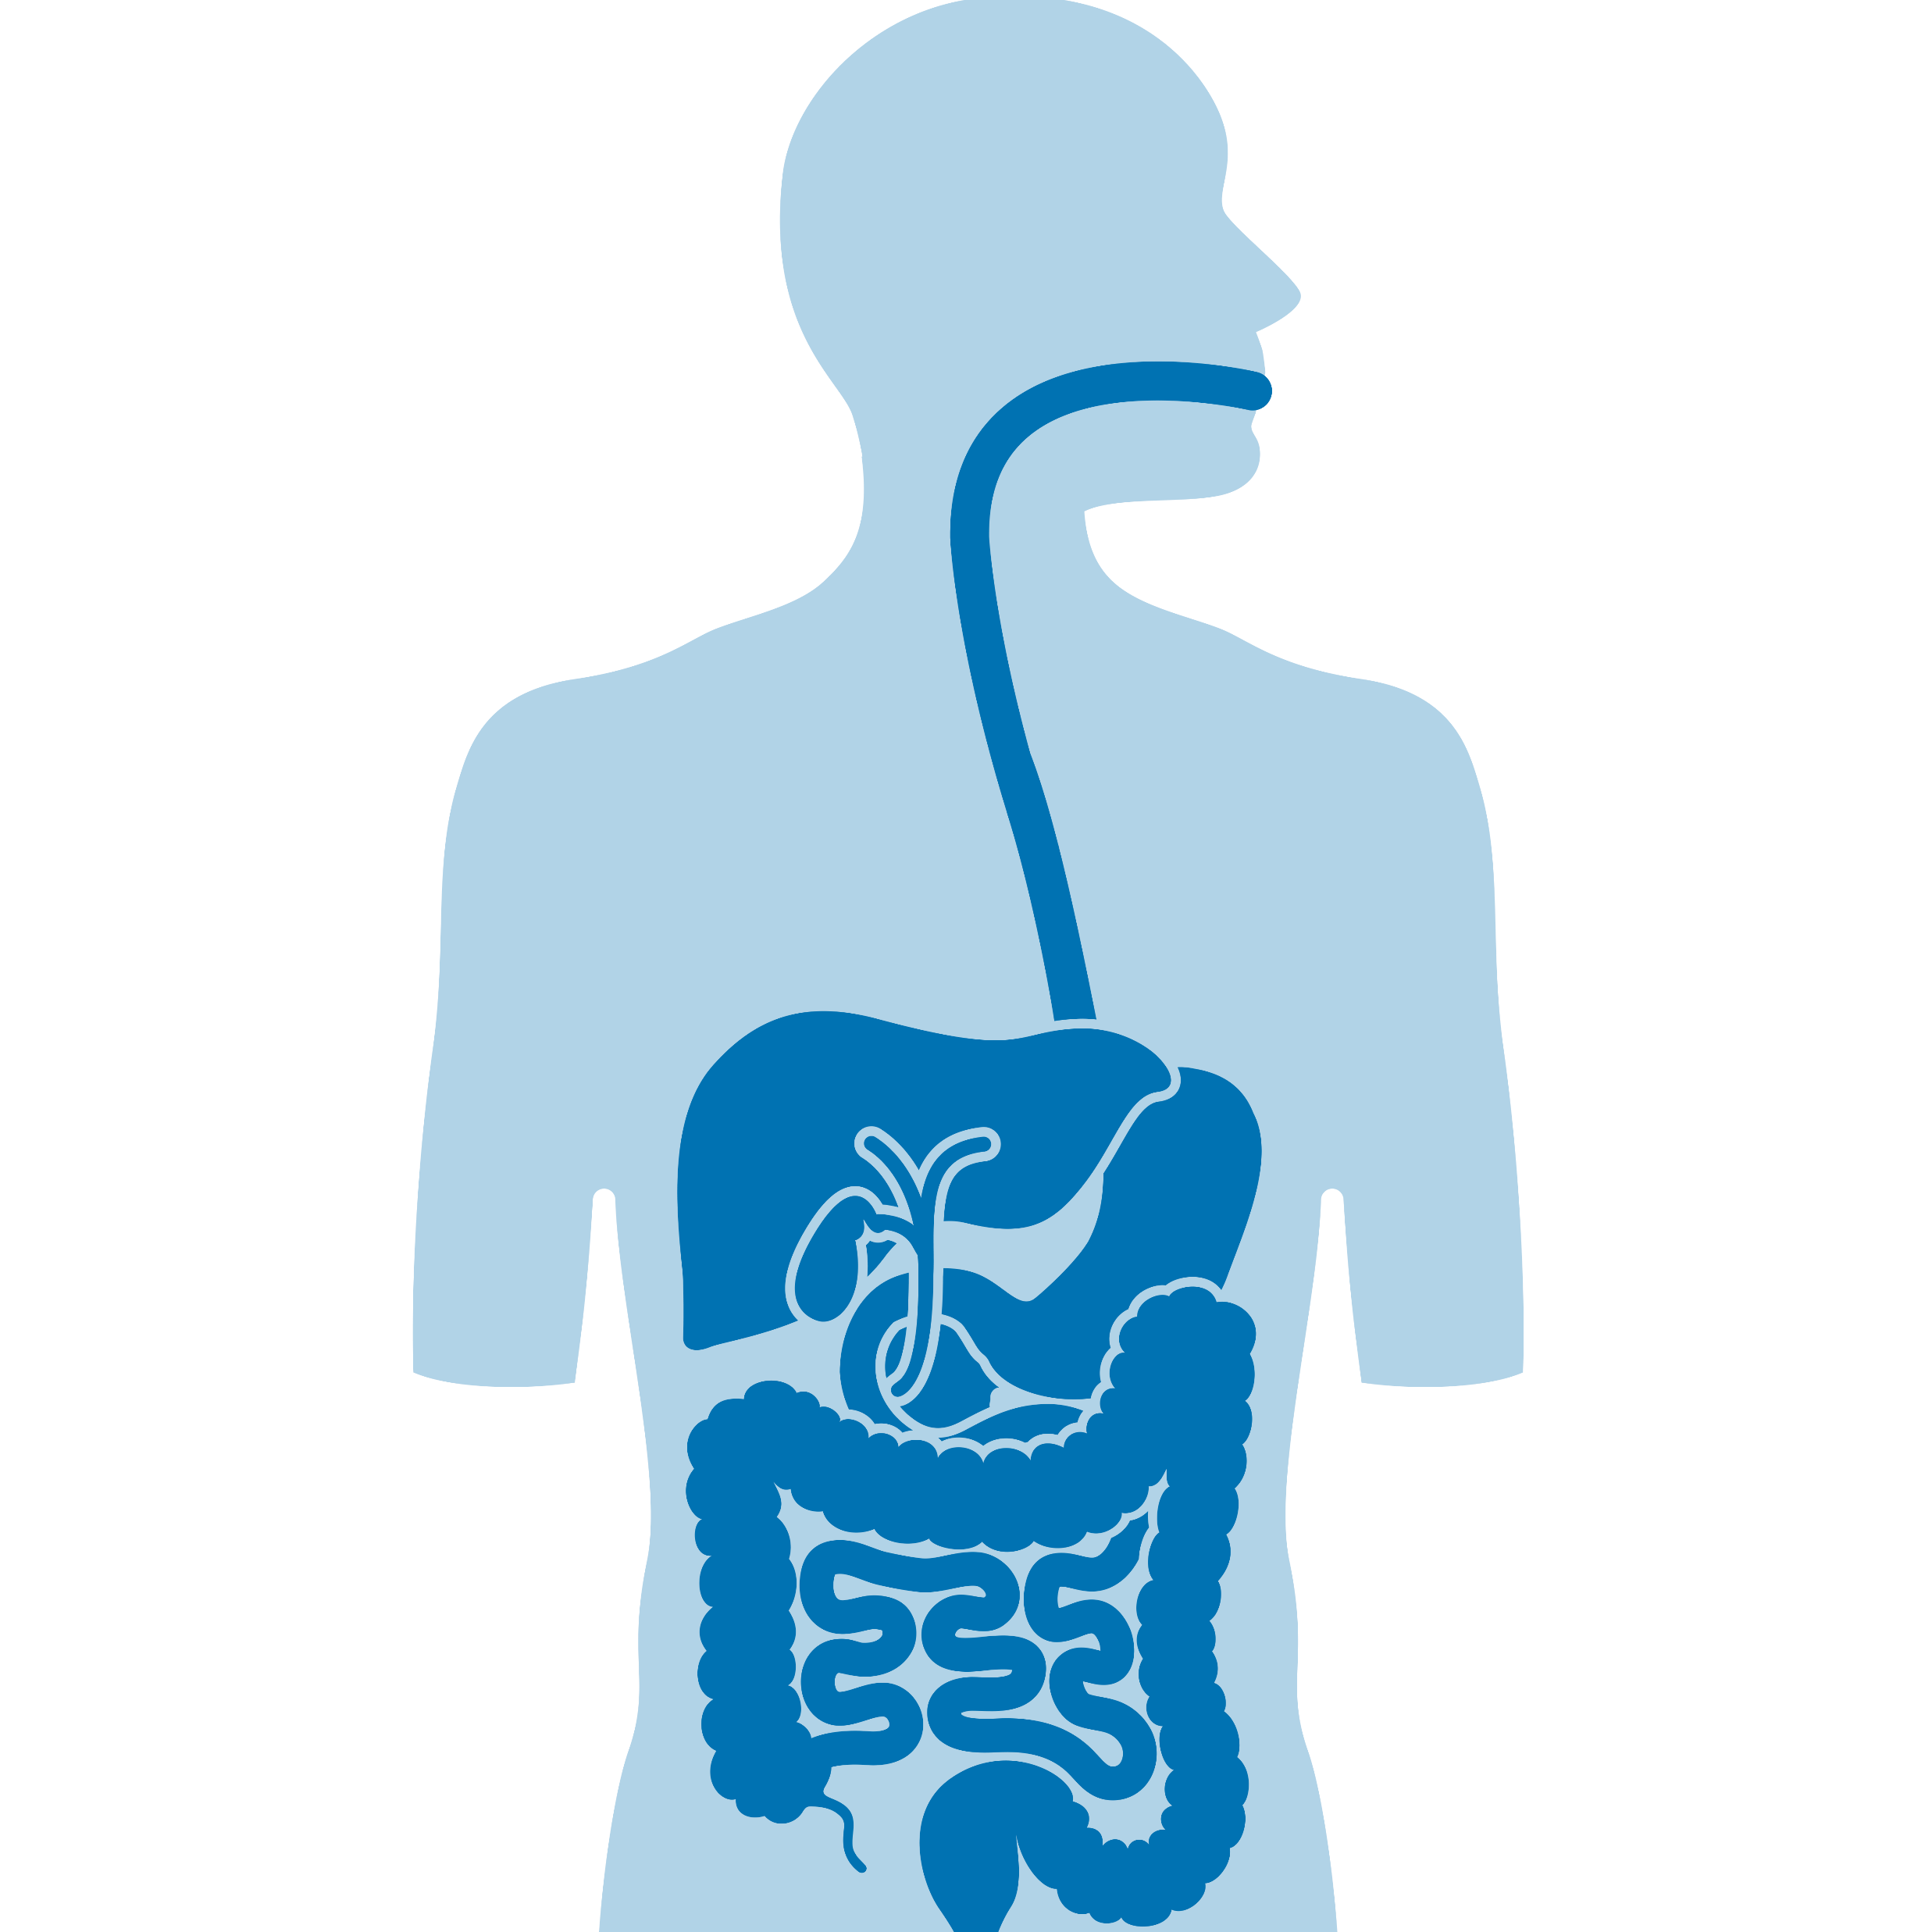
GI organs I
Copy from
this slide

Slide 3
GI organs II
Cancer Cells
Copy from
this slide

Slide 4
GI lesions: Polyps
Cancer Diverticulum
Copy from
this slide

Slide 5
GI tools I
Copy from
this slide

Slide 6
GI tools II
Miscellaneous
Copy from
this slide

Slide 7
Humans
Sign to indicate „lesion“
Copy from
this slide

Slide 8
Medical Icons Font
The font "Medical Icons" offers a large number of medical icons you can use too.
For this please open the symbols menu, change to the font „Medical Icons“ and subset „Private Use Area“.
If the font does not display, you can download it here.

